Slide 1
Culturally Responsive Teaching
September 21st, 2018
Notes:
I want to focus this PD on areas of Culturally responsive teaching that we might not be familiar with. This PD is meant to add-on to what teachers already know about culturally responsive teaching. I also want to be transparent and let you all know that we will not be spending time examining our own culture. That is something I encourage all of us to do individually and as a team, but is an area of culturally responsive teaching that is well-known already. If needed or wanted, we can create a follow up PD focusing on examining our own cultures, and student’s culture and how the differences in cultures lead to misunderstandings and assumptions.

Slide 2
Aims and Norms
Respect one another’s time
Be Kind, Smile, and Always say Hello
Equity of Voice
Agree to Disagree
Assume Best Intentions
Always Operate on a growth mindset
Be present and active during meetings
Respect each others voices and opinions
Teamwork
Be supportive
All responsible for student’s work
TWBAT define cultural responsive teaching.
TWBAT brainstorm ways to make lessons culturally responsive.
TWBAT incorporate culturally responsive teaching into one lesson for the following week.

Slide 3
Agenda
Culturally Responsive Teaching and the Brain
Jig-saw
Lesson Planning Activity
Holidays and Celebration
Wrap up

Slide 4
What is Culturally Responsive Teaching?
Culturally Responsive Teaching is a pedagogy that recognizes the importance of including students' cultural references in all aspects of learning (Ladson-Billings,1994).
Students need to see themselves in the curriculum in a way that makes students and families feel invited and welcome.
It is a way to differentiate instruction so that all of our students have the same opportunity to learn.
Notes:
1.Show slide and ask teachers what they think culturally responsive teaching is
2. Share definition and read
3.. Name the difference between Multicultural education and CRT- Multicultural Education centers around creating positive interactions and celebrating diversity and difference.It concerns itself with exposing privilege student to diverse lit, multiple perspectives, and help Ss of color see themselves reflected. Examples are multicultural books, and bulletin boards. Whereas Culturally responsive teaching center around the cognitive aspects of teaching and learning. It concerns itself with building academic mindset by making student’s culture the center of education. We should definitely incorporate multicultural education and socio-justice lessons throughout the year.
4. What impact does a culturally responsive curriculum have? A study from the University of Arizona found that Latino students in Tucson Unified School District where 46-150 percent more likely to graduate HS. This was supported by another independent study.

Slide 5
Culturally Responsive Teaching
Integrate students’ culture into the curriculum, not an add-on.
Add-on Reading about Martin Luther King Jr. only during Black History Month or MLK day Lunar New Year’s art and Craft activity Learning about Columbus’ Day or Thanksgiving from one point of view and only during one day Creating traditional ceremonial dress, as an arts and craft activity in an inauthentic way. | Integration Incorporating diverse literature where students’ cultures, experiences, names, race, and ethnicity is authentically shared throughout the school year. Learning about Holidays, religious celebrations in academic ways. Letting students come into the classroom to share about their culture. Bringing multiple perspective into the learning (i.e. Native American Point of View regarding Columbus’ Day, Thanksgiving Day) Asking Higher Order Thinking questions
Notes:
Show Slide
Share the differences between add-on and integrated curriculum
What are ways that you have integrated students culture in your classroom? How do we develop student’s capacity to learn. Remember, CRT helps students build resilience process information using what they already know.

Slide 6
Levels of Culture
Surface Culture
Dress, food, holidays, traditions
Shallow Culture
Unspoken rules such as personal space, eye contact, touching, nonverbal communication
Deep Culture
View of good and bad, competition vs. cooperation
Notes:
Show Slide, but not words
Create cultural knowledge tree and post. Have teacher come up and write or post elements of a culture.
Surface culture- the most observable patterns. This has a low impact on trust
Shallow- the behaviors and norms. The interpersonal levels. This has a very high impact on trust.
Deep- how we get to be ourselves based. Racial, ethnic, and national culture. Many cultures also value collectivism. The USA is the most individualistic country in the planet. But a country like Guatemala is almost exclusively a collectivist society. One way to know what a culture values is by reading fairy tales. Find the same fairy tale, such a Cinderella, and learn about the moral of the story. Many cultures value things such as kindness.
Turn and Talk with a person at your table to share out some aspects of your culture that is surface, shallow and deep. (for example, surface level works will be rice and beans, shallow, untime for many events, deep, honesty is valued)

Slide 7
Notes:
CRT is about getting students engaged in the learning. We want students to develop high attention and high commitment to education.
First part of CRT is TRUST. Teachers need to build trust with students and families. To learn how to do this, we will learn a little about the brain because similar to trauma informed practice, the brain registers social dangers the same way that it approaches physical dangers. This means that if a student feels unsafe participating in the classroom, their brains will react the same way as if a trauma was occuring.
As teachers we need to build relationships with students. We have to care and make them feel cared for. This is done through building trust.
How can do we build trust with our students? Shout out some ideas, I will write them down
Those are some ideas, please keep them in mind as we learn about the brain.See if any of your ideas are challenged.

Slide 8
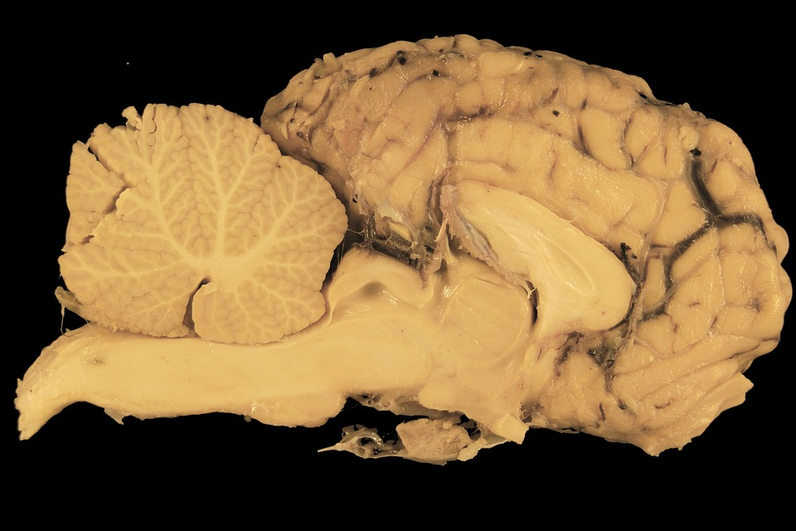
Culturally Responsive Teaching
and the Brain
Brain is made up of different parts
The Reptilian Region
First layer of the brain. It is made up of the brainstem and the cerebellum. It doesn’t think. It only reacts. This part of the brain searches for danger around us and alerts when dangers are perceived.

Slide 9
Culturally Responsive Teaching and the Brain
The Limbic Region
Found right on top of the reptilian region. It is also called the emotional brain. The primary role of the limbic region is to learn from experience, manage emotions, and remember. There are 3 structures of the limbic brain that helps maintain memories and emotions.
Thalamus- The dispatch hub. All incoming sensory information comes here first (except smell)
Hippocampus- The brain’s background knowledge bank It houses short-term and long-term memories.
Amygdala- Triggers our “fight or flight” response. Can also hijack all other cognitive functions such as learning, problem solving, or creative thinking.
Notes:
Create an environment where students feel relax in the classroom stage. Remember that students learn when they feel safe and trust the environment. Teachers can work on creating a calm environment by showing care for the students, while also setting high expectations.
I want to quickly mention a study done by Claude Steele, a former Stanford Professor and educational researcher, she learned about something called the Stereotype Threat. Stereotype threat is a type of racially-charged amygdala hijack. It happens when a student becomes anxious about him/herself as a learner and assumes that he or she will fail. Engaging in classwork could confirm these fears for the student. It also leads to the release of the stress hormone cortisol, which in turn reduces the amount of working memory available to him/her to perform complex cognitive work. Remember we need students to feel like they are in a safe environment, use students’ culture to show that you care about them.

Slide 10
Brain Cont.
Neocortex Region
It is slow in processing information
Home to our executive functions- the command center of the brain
It overseas thinking and manages our working memory. It controls planning abstract thinking, organization, and self-regulation
This part of the brain is very important and where most of what is needed to succeed in school. The problem is getting here from the RAS--reticular activating system--(located in the reptilian region) and the amygdala.

Slide 11
Great… I know about the brain now, why does that matter in the cultural responsive classroom?
Glad you asked! Well our culture is the way our brain makes sense of the world around us. If the classroom is a safe environment, which can be achieved by embracing student’s cultures, our brains will focus on the learning.
Notes:
Pass out copies of pages 47-49. Create Jig-Saw

Slide 12
Lesson Planning
What can I do with all of this information?
How can you incorporate one aspect of culturally responsive teaching into one lesson next week?
Notes:
From the readings of pages 46-48- List some ideas that teachers can use in lessons. Example, incorporate HOT questions in reading street. Use cultural knowledge to teach new ideas.
When planning lessons, you do not have to mention race and issues in every lesson. That is not what CRT is. We are using culture as part of instruction delivery. Use what students know from experience to your advantage.
Remember that many of your students culture are collectivist cultures and have rich oral traditions. How can you use memory games, perspectives, puzzle and patterns and word play to engage our students in learning.
Some suggestions, have students engage in problem based-learning. Students need to feel that their brain is being stretch, but comfortable enough continue working.
You can also work on incorporating music and dance, as well as poem, song, mnemonic,chants, and call and responses
Here are some ways that we already engage in culturally responsive practices. During morning we have created rituals like reciting the SHARK Pledge. We have invited parents to share about their culture. We allow our students to talk (believe it or not some schools don’t).

Slide 13
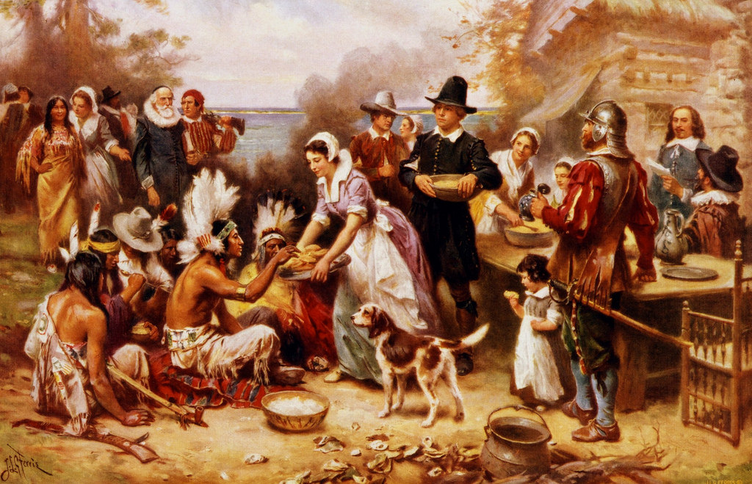
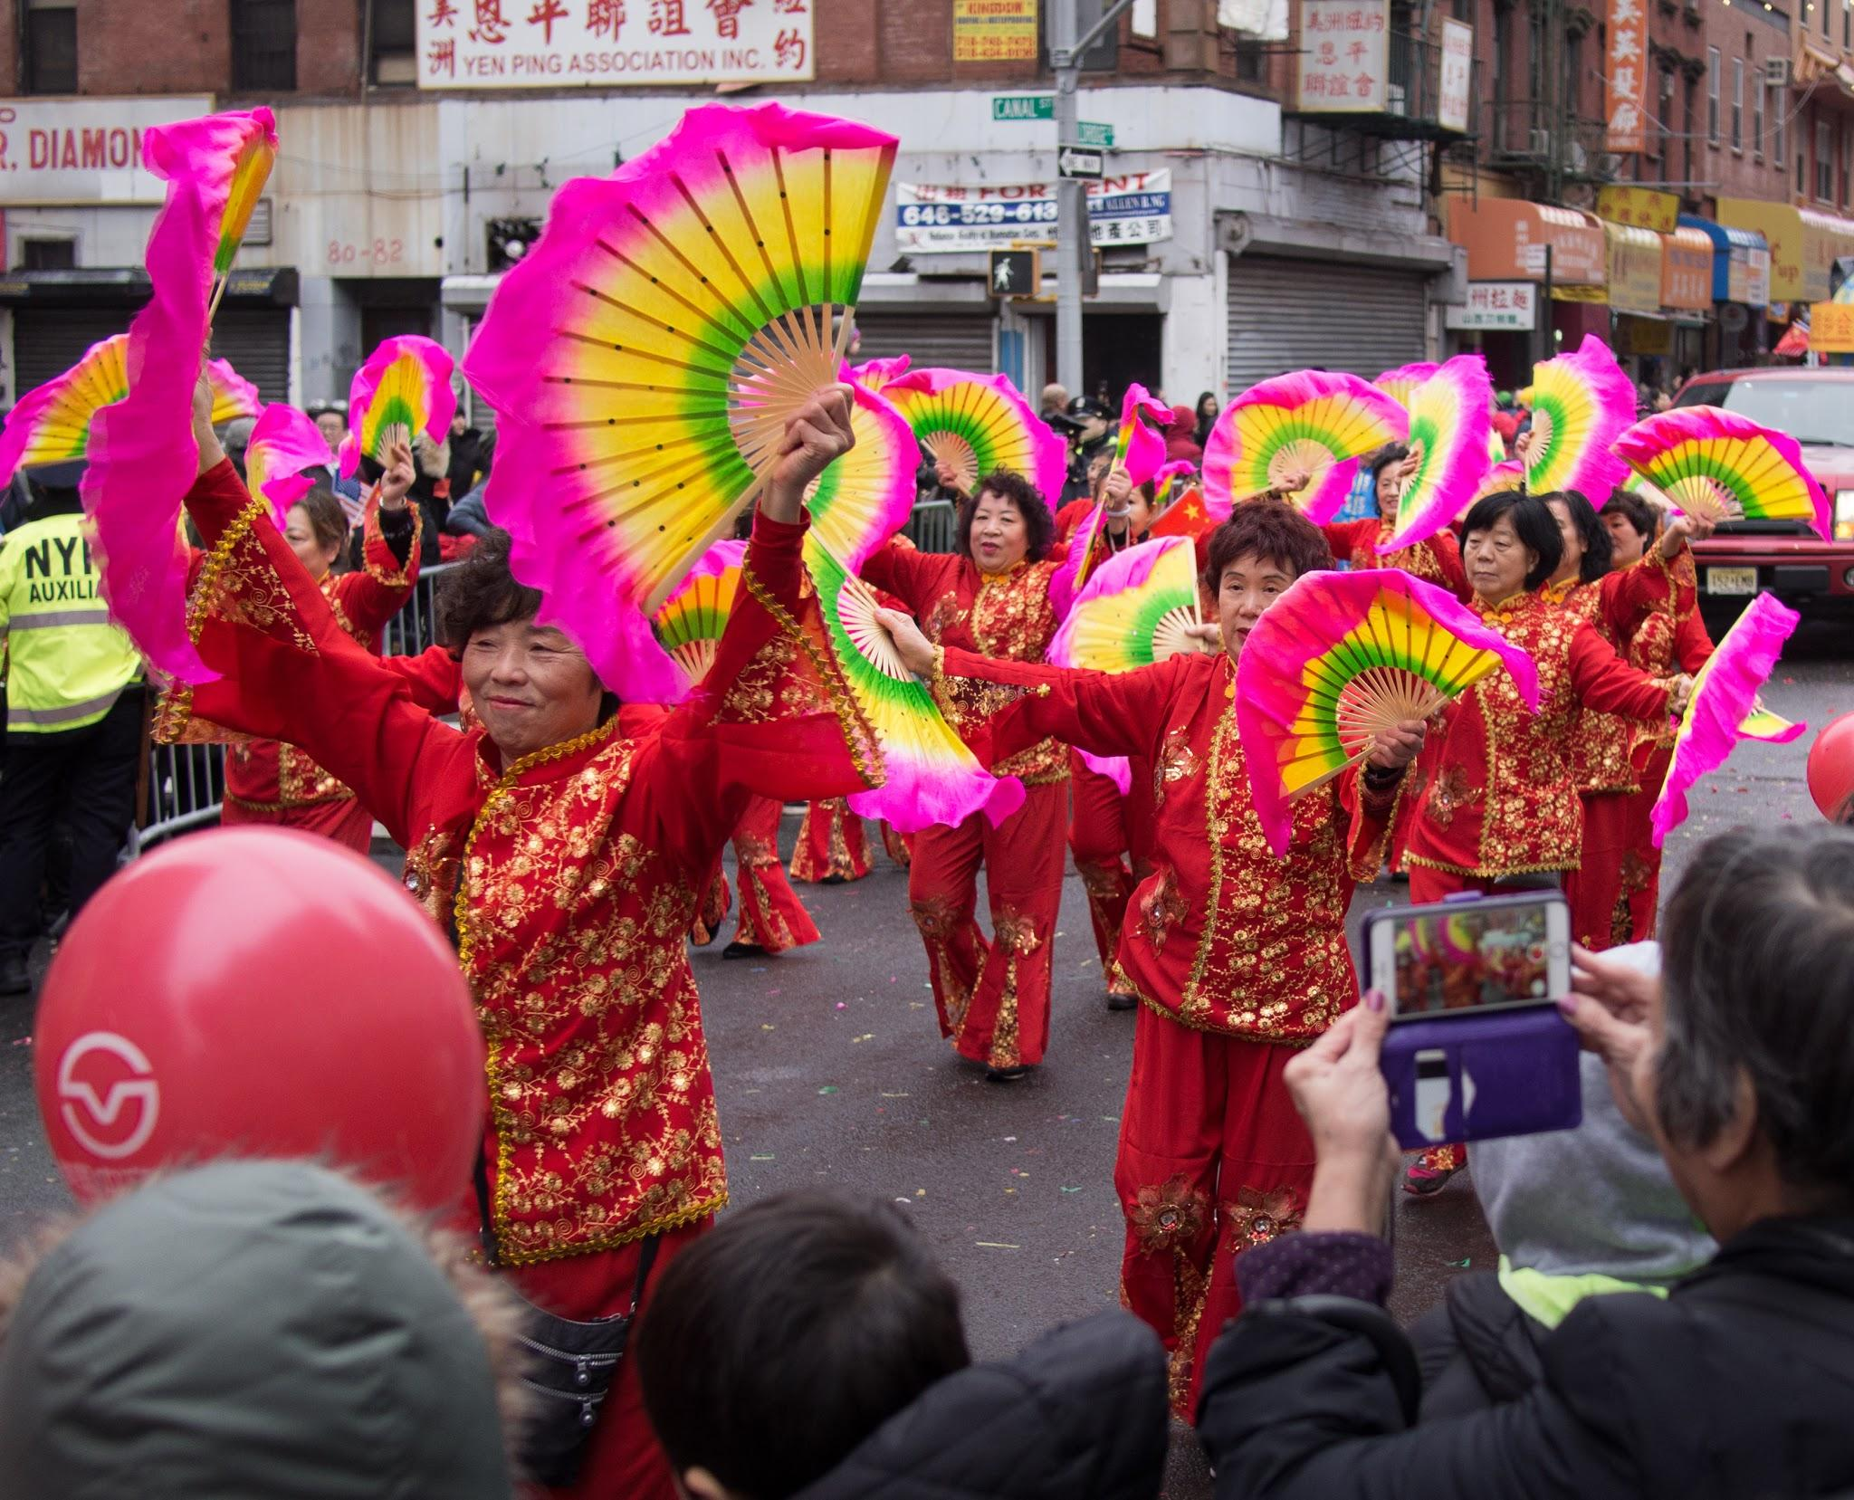
Holidays and Celebrations
Notes:
Think back to your own schooling, what were some ways that holidays, if any, were celebrate?
What traditions or ideas have you carried into your own classroom activities from your childhood? If you have carried any, have you changed anything?
Just like culturally responsive teaching, holidays do not live in a vacuum. When teaching holidays, it is important incorporate holidays in the curriculum and provide students with multiple opportunities to engage in an authentic, academic way.
If teaching controversial holidays, such as Columbus’ Day or Thanksgiving, it is important to focus on the history of the holiday from multiple perspective, instead of an arts and craft activity. If you wish to work on an arts and craft activity, focus on activities that are not stereotypical depictions of minority groups.
If working on a craft that is deemed traditional, make sure to alway preface the activity by building background knowledge.
We have some holidays coming up soon. I want you to learn more about the common holidays that teachers mention and might even create activities for. As you are reading through the websites think of ways that you can teach the content in age-appropriate ways, and any activity that you could do in a culturally responsive way. Holidays at school should not be taught in a religious way. If any holiday is going to be celebrated it has to be in a secular, academic way. That means no xmas trees, native American feathers. If you are teaching about one winter holiday, teach about all the holidays celebrated during the same span of time.
https://newsela.com/read/columbus-thanksgiving-history/id/37897/ (Great article written in child friendly terms)
https://www.tolerance.org/classroom-resources/tolerance-lessons/thanksgiving-mourning
https://kids.nationalgeographic.com/explore/history/first-thanksgiving/
http://www.uaine.org/default.htm
http://www.indigenouspeoplesdayma.org/about/
https://www.readinga-z.com/books/leveled-books/book/?id=1722&lang=English (The Legend of Nian)
https://www.readinga-z.com/books/leveled-books/book/?id=140&lang=English (Holidays around the World)
http://www.officialkwanzaawebsite.org/index.shtml
https://kids.nationalgeographic.com/explore/history/ramadan/#ramadan_lights.jpg
BrainpopJr.com (social studies section)
https://newsela.com/read/lib-history-chinese-new-year-traditions/id/25182/

Slide 14
Wrap up
Culturally Responsive Teaching is not a multicultural education or a socio-justice curriculum. It is not about race, racism, or culture. Instead, it is teaching that embeds culture in the curriculum year-round.
CRT engages the learner by including trust, rigor, and collective learning into the curriculum.

